Slide 1
BACKEND

Slide 2
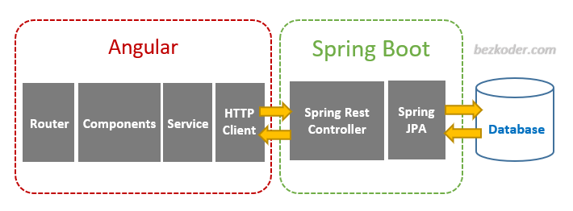
Project Architecture

Slide 3
Spring Boot Components
Rest Controller
Service
DAO (Data Access Object)
Repository
Entity

Slide 4
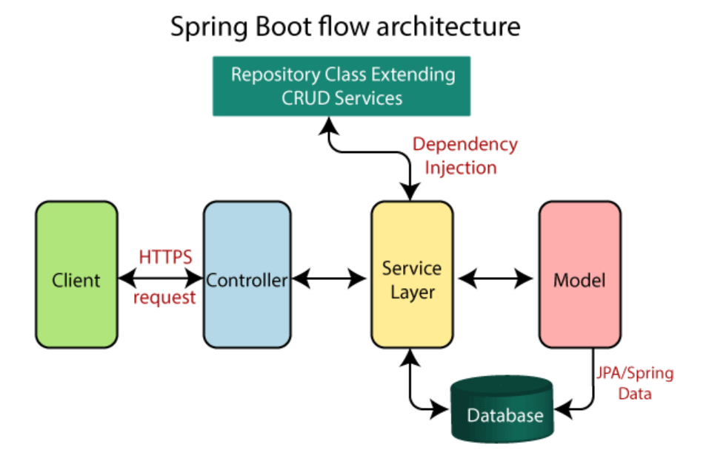

Slide 5
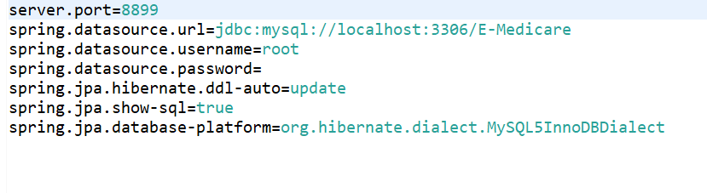
Application Properties

Slide 6
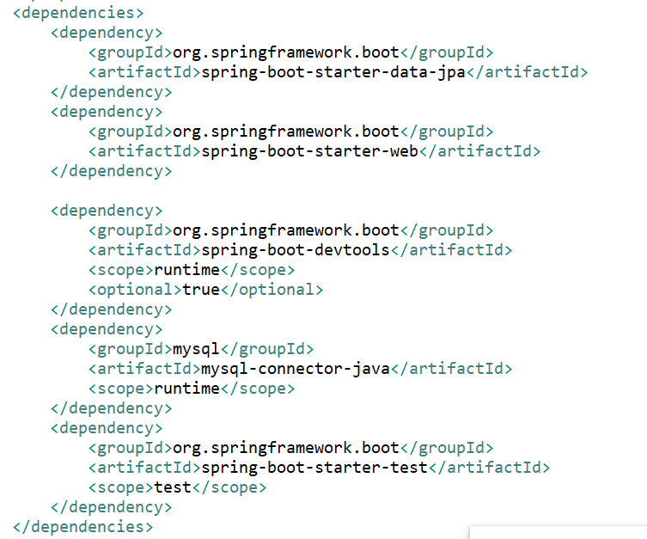
Dependencies

Slide 7
Rest coding continuous…..

